Slide 1
Regression and Assumptions

Slide 2
Background on Regression

Slide 3
What is Regression?
Statistical test for prediction
Type of modeling
Allows for continuous IVs and continuous or categorical DVs
Analysis | DV Type | Levels of DV
Binary Logistic Regression | Categorical | 2
Multinomial Logistic Regression | Categorical | 3+
Linear Regression | Continuous | NA

Slide 4
Types of Regression
Linear – Data forms a straight line
Non-linear – Data does not form a straight line
Logistic – DV is categorical
Simple – One IV
Multiple – Multiple IVs
Stepwise/Hierarchical – Assess each IV one at a time to see how important it is to the outcome

Slide 5
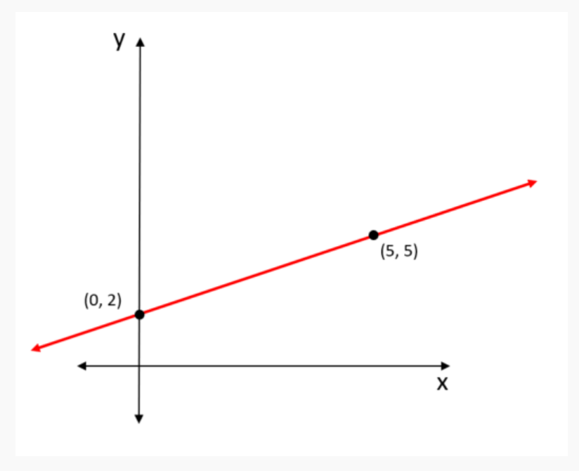
Parts of a Regression Line
y = mx + b
m - Slope – how steep the line is
b - Intercept – where the line starts on the y axis
Residual – how different the predicted line is from the actual line
AKA error

Slide 6
Assumptions of Linear Regression

Slide 7
Assumptions of Linear Regression
Linear relationship between x and y
Homoscedasticity – normal distribution of your error
Homogeneity of variance – change in error is the same for all values of x
Xs are measured without error
Absence of Multicollinearity – observations are independent without too much overlap
Lack of outliers

Slide 8
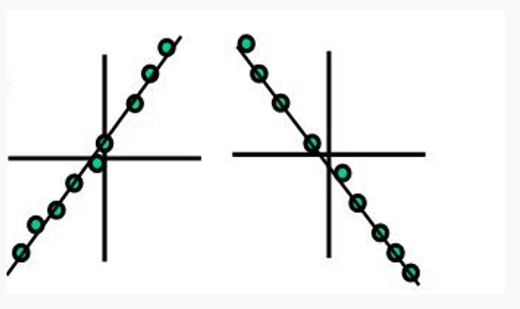
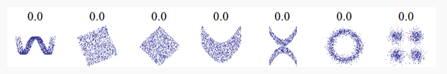


Linear
Relationship between x and y must be linear

Slide 9
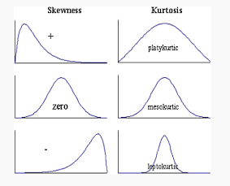
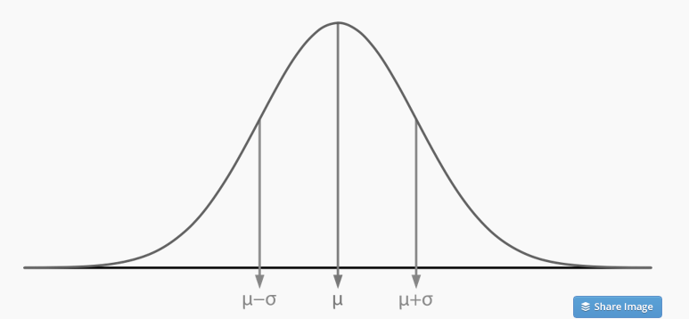
Homoscedasticity
Normal Distribution of the error

Slide 10
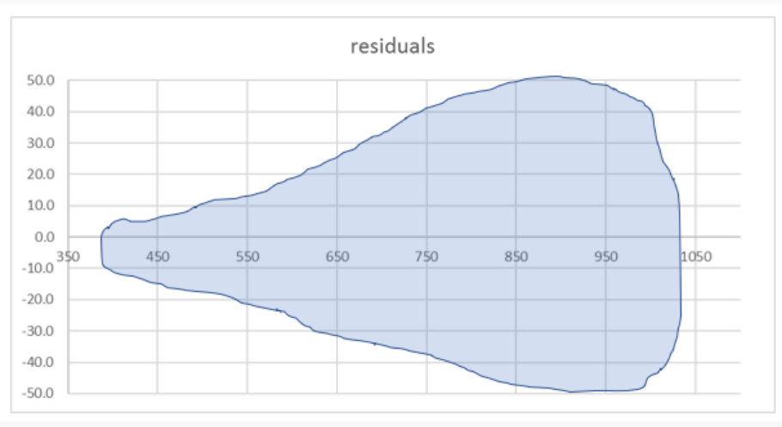
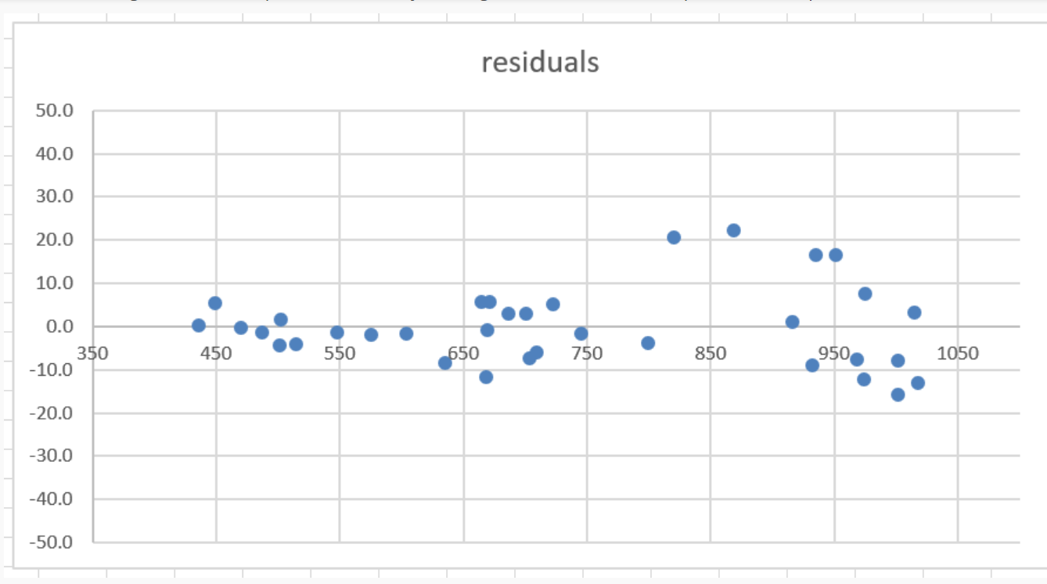
Homogeneity of Variance
The change in the error is the same at all levels of x

Slide 11
X as a Known Constant
Xs are measured without error
Good luck verifying this or achieving it!

Slide 12
Absence of Multicollinearity
Y values are independent
Knowing something about one data point DOES NOT mean you know something about another one

Slide 13
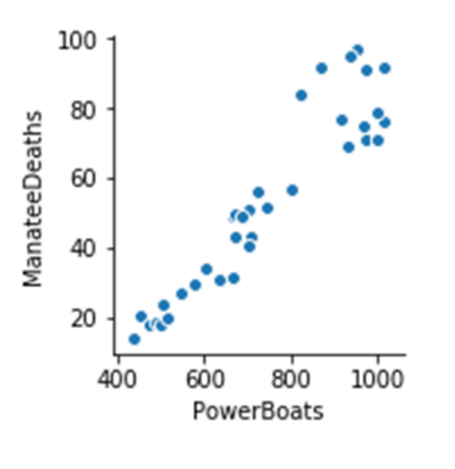
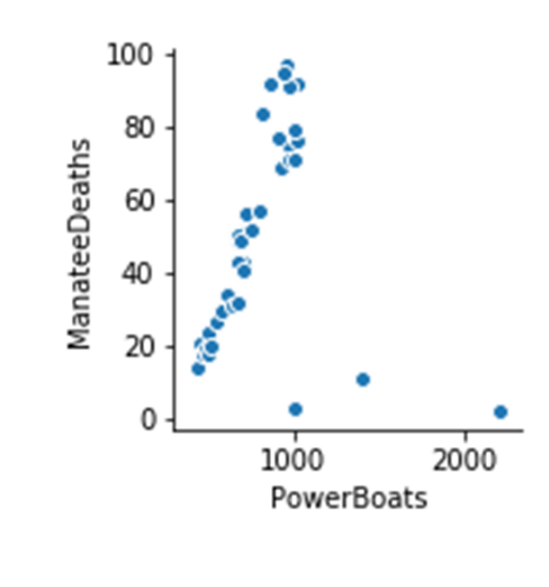
Absence of Outliers
Data points not near any others
Can skew your data

Slide 14
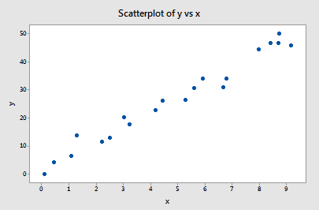
Types of Outliers
Leverage - extreme value in x space
Distance – extreme value in y space
Influential – extreme in both x and y space
Influential
Distance
Leverage

Slide 15
Questions?

